Slide 1



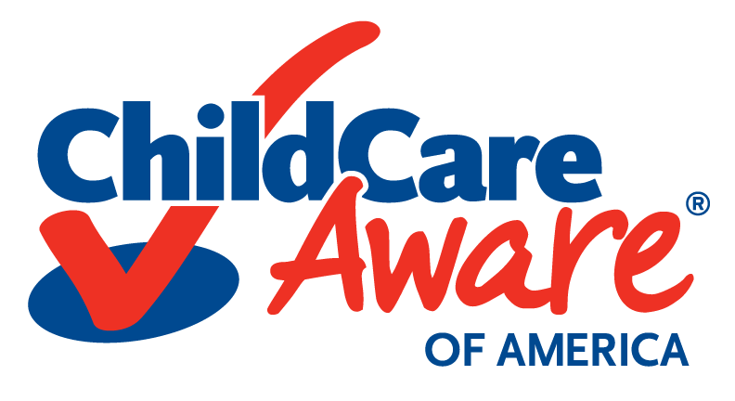
Pediatric Response Issues in a Disaster
R2N Annual healthcare
coalition education conference
Notes:
NOTE: To replace a picture, just select and delete it. Then use the Insert Picture icon to replace it with one of your own!

Slide 2

EMERGENCY Preparedness
ANDREW ROSZAK, JD, MPA, EMT-P
Senior Director
Emergency Preparedness
Andrew.Roszak@usa.childcareaware.org
@AndyRoszak
Copyright Child Care Aware® of America.
Notes:
NOTE: To replace a picture, just select and delete it. Then use the Insert Picture icon to replace it with one of your own!

Slide 3

Child Care Aware® of America (CCAoA) is a non-profit organization that serves as our nation’s leading voice for child care.
CCAoA works with Child Care Resource & Referral Agencies (CCR&Rs) across the country to help ensure that all families have access to quality, affordable child care.

Slide 4
Child Care Resource & Referral Agencies
WHO THEY ARE
WHAT THEY DO
Help more than 860,000 families find, evaluate or pay for child care each year
Train more than 580,000 child care providers a year.
58% administer child care subsidies for their state or county.
62% analyze and report on child care supply and demand.
There are more than 600 CCR&Rs across the country, staffed by professionals who provide a bridge between parents, providers, community leaders, and policymakers.
Provide a voice for quality early childhood settings at the local, state and national level.

Slide 5
CCR&R Role in Preparedness
Child Care Resource and Referral Agencies are a constant presence in local communities and serve as a trusted resource for child care providers and families.
CCAoA believes that resilient communities must have preparation, relief, and recovery systems in place to ensure that children are safe and that families can return to work.
With the proper training and resources, CCR&Rs can serve as resilience hubs that reduce, and possibly prevent, the suffering of people affected by disasters—especially those most vulnerable.

Slide 6



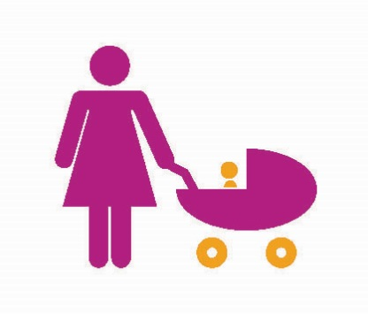

CHILD CARE: BY THE NUMBERS
Throughout the nation, nearly 11 million children under the age of five receive child care
There are 297,400 child care programs in the United States, including both home and center-based facilities
Children make up nearly 25 percent of the population in the United States
Most children spend an average of 36 hours each week in child care
There are approximately 4.7 million child care providers in the United States
Copyright Child Care Aware® of America.
Notes:
NOTE: To replace a picture, just select and delete it. Then use the Insert Picture icon to replace it with one of your own!

Slide 7

Current Landscape
Times have changed…
Half of all mothers, and only a third of mothers with children less than three years old, worked outside the home forty years ago.
Today, nearly 75 percent of mothers are in the labor force, including 61 percent of mothers with children less than three years old

Slide 8
CHILD CARE: DISASTER OVERVIEW
Each workday, 69 million children are in child care or school, separated from their families.
18 states and D.C. lack basic standards for protecting children in child care facilities and schools. Save the Children
More than half of American families don’t have an emergency plan. FEMA
79% of recommendations made by the National Commission remain unfulfilled 10 years after Katrina.
Following Hurricane Katrina, it took 7 months to reunite the last child with her family. National Commission on Children in Disasters
Children affected by large disasters are five times as likely to have serious emotional issues than those who are unaffected. Children’s Health Fund; Columbia University
Notes:
NOTE: To replace a picture, just select and delete it. Then use the Insert Picture icon to replace it with one of your own!

Slide 9

Child Care and Development Block Grant
Child Care and Development Block Grant (CCDBG) Act of 2014, signed into law by President Barack Obama on 19 November 2014.
This law reauthorized the CCDBG Program, the primary federal funding for child care assistance for families.

Slide 10

Child Care Development and Block Grant
The Act also contained a requirement for states to develop statewide child care disaster plans. States must certify that these disaster plans are fully implemented by March 1, 2016.
If a state cannot meet the March deadline, they can request an extension until September 2016.

Slide 11
CCDBG Requirements
“Guidelines for the continuation of child care services in the period following the emergency or disaster, which may include the provision of emergency and temporary child care services, and temporary operating standards for child care providers during that period; and procedures for staff and volunteer emergency preparedness training and practice drills.”
“Evacuation, relocation, shelter-in-place, and lock-down procedures, and procedures for communication and reunification with families, continuity of operations, and accommodation of infants and toddlers, children with disabilities, and children with chronic medical conditions.”
States are required to create these plans by 30 September 2016.

Slide 12

Pilot Program
Child Care Aware® of America (CCAoA) will launch a new emergency preparedness training and technical assistance program for Child Care Resource and Referral (CCR&R) agencies in three communities, increasing the capacity of CCR&Rs to serve as resilience hubs in their communities in the case of emergencies or natural disasters.
The three states selected will be chosen from the following: AR, IA, KS, MN, MO, MT, ND, NE, OK, SD.
The program will develop a train-the-trainer initiative for CCR&R staff and provide funding support to resource and referral agencies to work with both center-based and home-based providers. The findings will be documented through a variety of channels, including white papers, infographics, and technology.

Slide 13
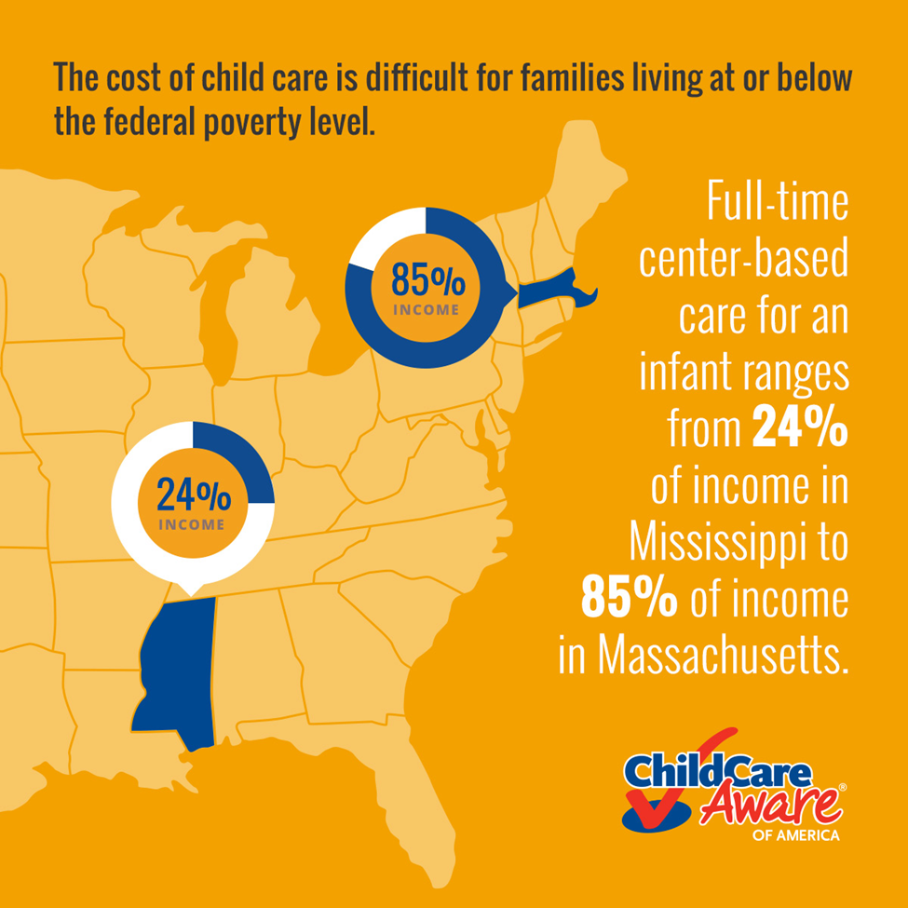
Current Landscape
Child Care is Expensive
Major expense, often exceeding the cost of housing, college tuition, transportation and food.
Child care can cost as much as $17,062 annually for an infant, or $12,781 annually for a four-year-old.
Child care workers would need to spend nearly 50 percent of their income in order to afford child care for their own children.

Slide 14

Michigan child care Reality
9,884,242
Total population in Michigan
1,050,796 Total families with children
Copyright Child Care Aware® of America.
Notes:
NOTE: To replace a picture, just select and delete it. Then use the Insert Picture icon to replace it with one of your own!

Slide 15

Michigan child care Reality
577,049 Children under age 4
880,716 Children aged 5 to 11
361,679 Single parent families
77,504 Working mothers with infants under 1 yr. old
Copyright Child Care Aware® of America.
Notes:
NOTE: To replace a picture, just select and delete it. Then use the Insert Picture icon to replace it with one of your own!

Slide 16

Michigan Child Care Expenses
Average annual fees for full time care:
Child Care Center Infant: $9,882
4 yr. old: $6,764
Family Child Care Infant: $6,764
4 yr. old: $6,552

Slide 17
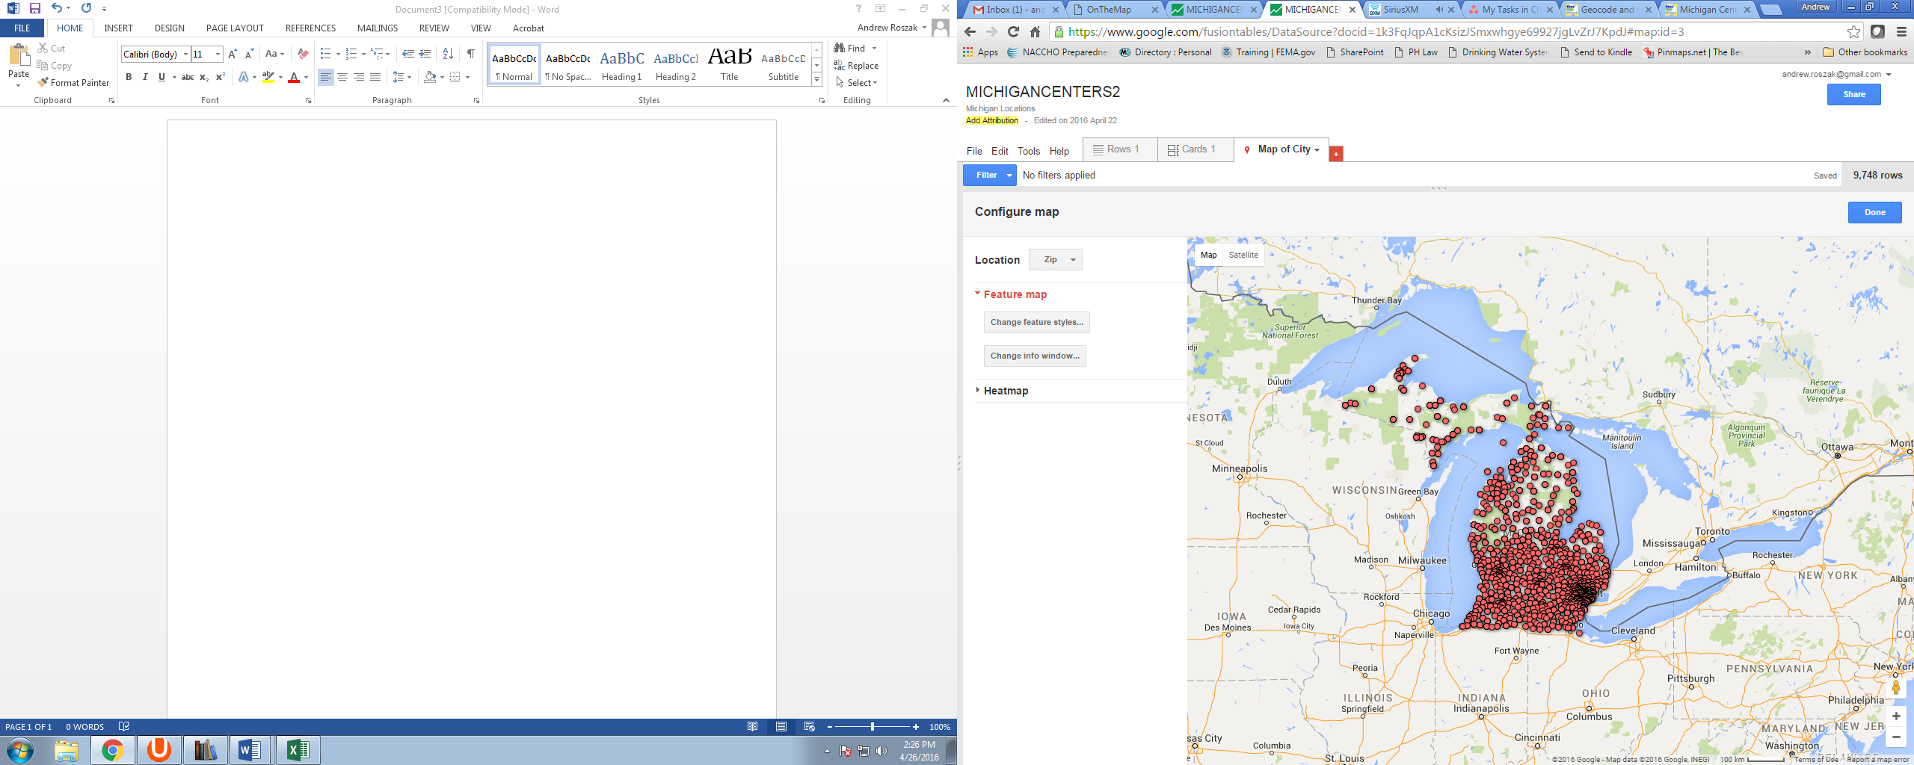
Michigan Child Care

Slide 18
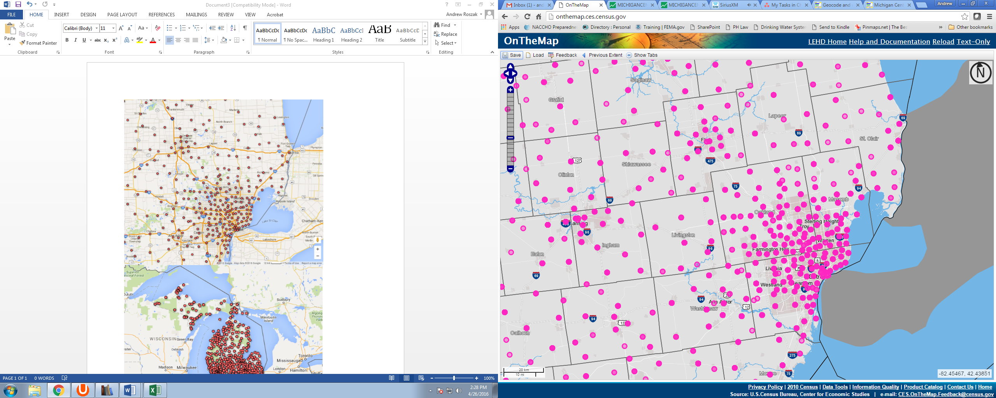
Michigan Child Care
Michigan has 9,749 licensed child care facilities
Representing a total capacity of 352,229 children

Slide 19
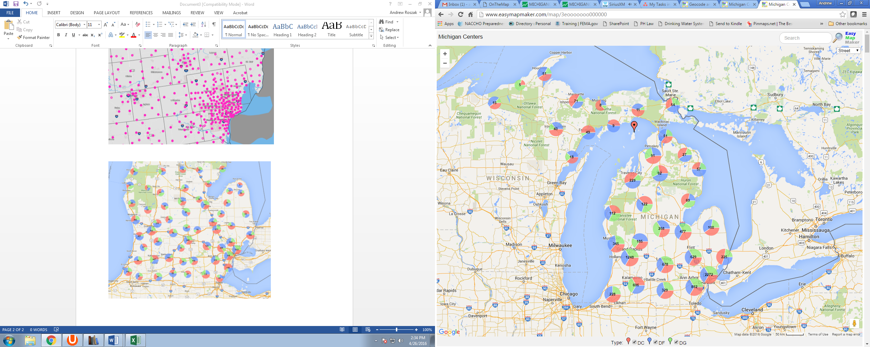
Michigan Child Care
Family Home = Blue
“Family child care home” means a private home in which 1 but fewer than 7 minor children are received for care and supervision for compensation for periods of less than 24 hours
Group Home = Green
“Group child care home” means a private home in which more than 6 but not more than 12 minor children are given care and supervision for periods of less than 24 hours a day
Child Care Center = Red
“Child care center” or “day care center” means a facility, other than a private residence, receiving 1 or more preschool or school-age children for care for periods of less than 24 hours a day, where the parents or guardians are not immediately available to the child.

Slide 20
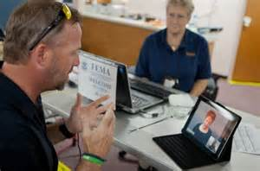
Major Disaster Declarations
Most Recent FEMA Major Disaster Declaration in Michigan:
September 2014
Severe Storms and Flooding
January 2016
Contaminated Water
Most Recent Emergency Declaration in Michigan

Slide 21
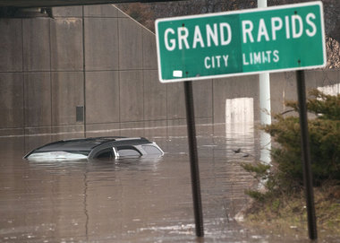
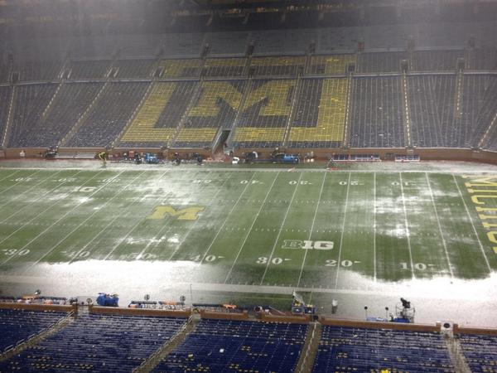
Major Disaster Declarations
2014- Severe Storms and Flooding
2013- Flooding
2008- Severe Storms, Tornadoes and Flooding
2004- Severe Storms, Tornadoes and Flooding
2002- Flooding
2000- Severe Storms and Flooding

Slide 22

Child Care and Emergencies
Caring for children is a big responsibility under “normal” conditions. However, when something out of control happens, such as a natural disaster, caring for children becomes an even greater responsibility.
The safety and well-being of children is a primary concern of child care providers. It takes a great deal of trust for parents to leave their children in child care, and when disasters occur, this trust takes on a new dimension.

Slide 23
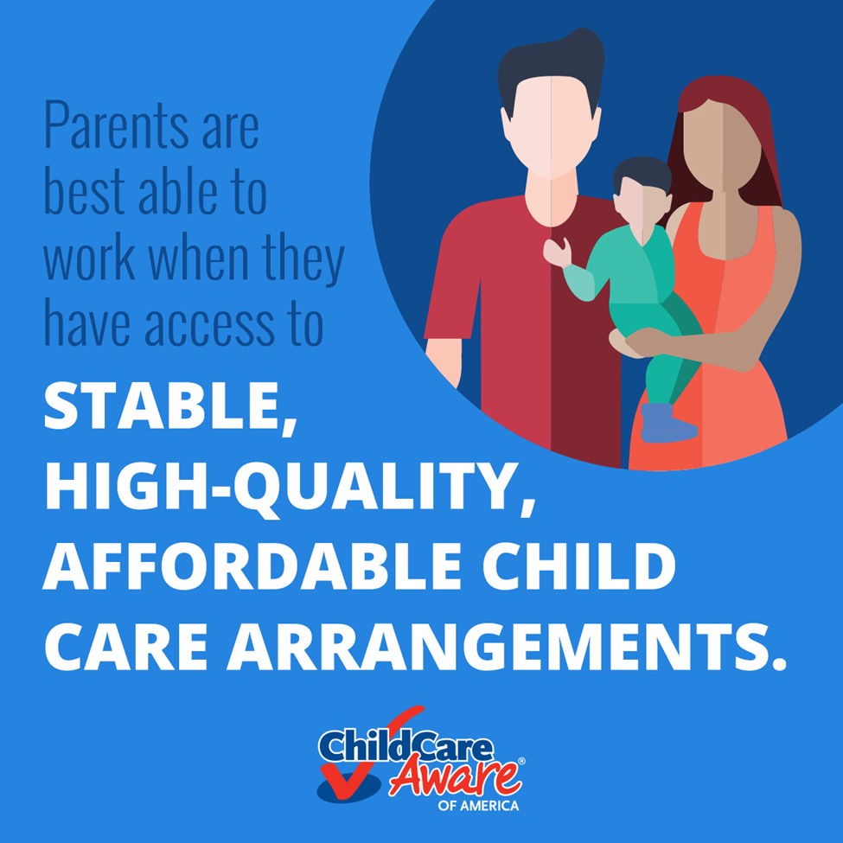
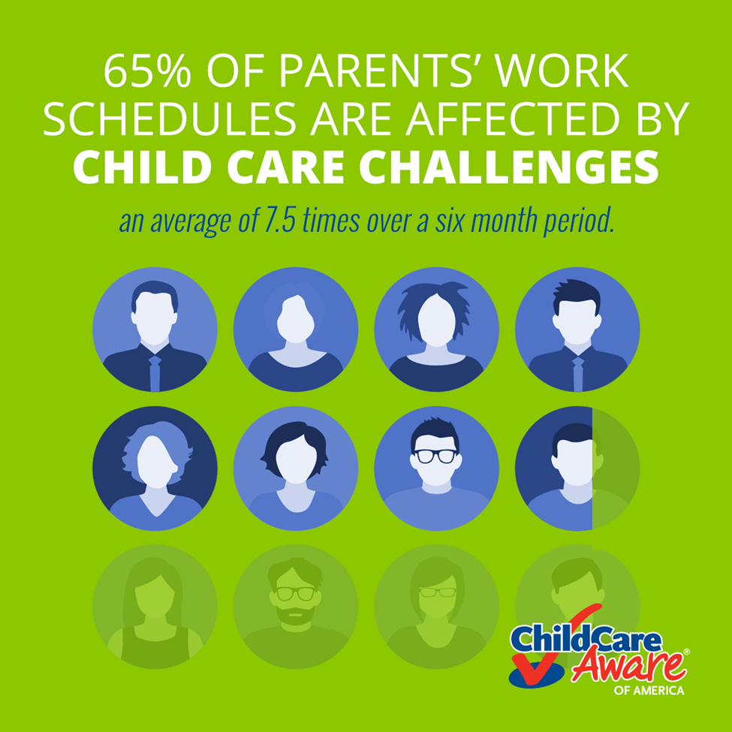
Child Care Recovery & Resiliency
Access to child care is a prerequisite for many before they can return to work.
Communities that ensure the availability of continued child care services during and in the aftermath of a disaster can expedite reopening businesses and reestablishing essential services.

Slide 24
Child Care Recovery & Resiliency
Prompt restoration of child care services allows first responders to return to work more quickly, without delaying to find a new source for child care.
This further provides a benefit to children, as they can return to a normal schedule and become reunited with their peers, thus restoring stability and familiarity.

Slide 25
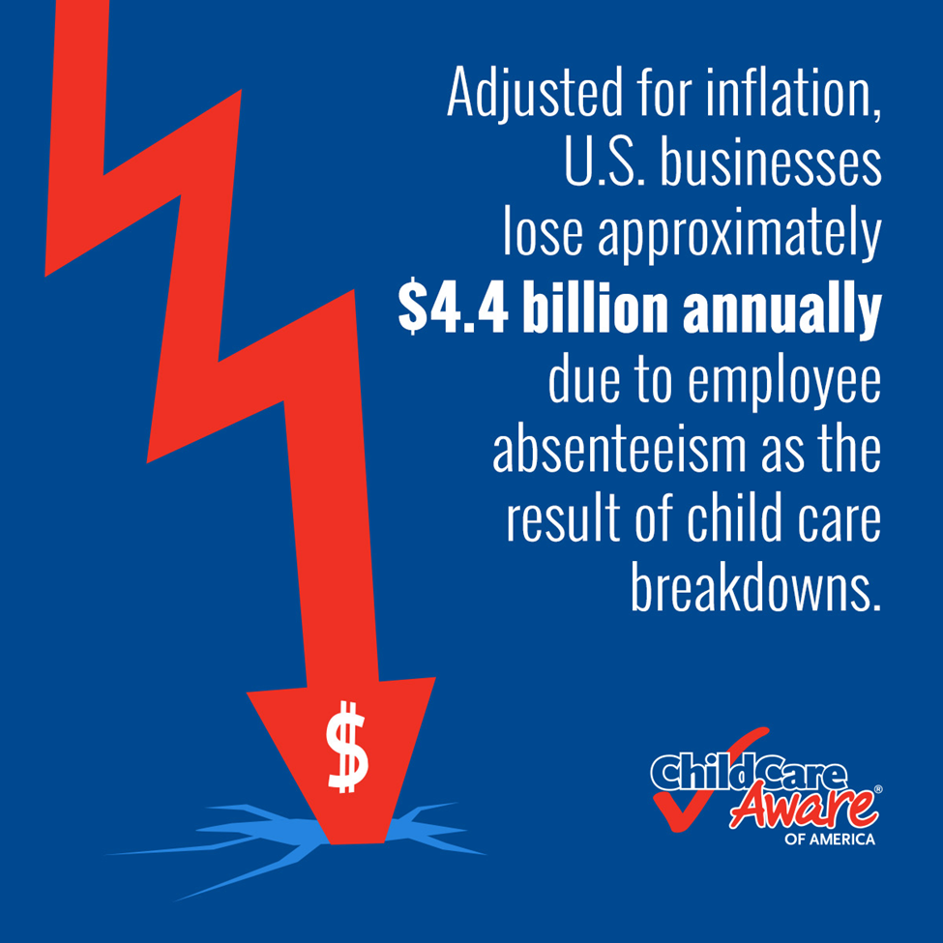
Child Care Recovery & Resiliency
A review of state Child Care and Development Fund plans revealed that in FY 2014 and 2015, only 19 of the 51 states addressed restoring or rebuilding child care facilities and infrastructure after a disaster in their emergency preparedness plans.

Slide 26

Preparedness Perceptions
Nearly two thirds (65%) of American households do not have adequate plans for a disaster or have no plans at all
41% of Americans are not confident that their community has adequate plans in place for a disaster that occurs with no warning and 37% are not confident in their community’s ability to meet the needs of children during disasters.
“Children in Disasters: Do Americans Feel Prepared? A National Survey.” Elisaveta Petkova, Jeff Schlegelmilch, Jonathan Sury, Tom Chandler, Cynthia Herrera, Shwetha Bhaskar, Erin Sehnert, Stephanie Martinez, Sabine Marx, Irwin Redlener. National Center for Disaster Preparedness at Columbia University’s Earth Institute, Research Brief 2016_1. (Release date 9 February 2016)

Slide 27
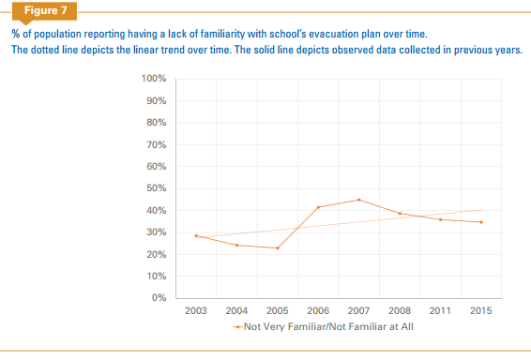
Preparedness Perceptions
Over a third of American households with children (35%) are not familiar with their child’s school evacuation and emergency plans, and even more (41%) do not know to what location their children would be evacuated to during a disaster.
“Children in Disasters: Do Americans Feel Prepared? A National Survey.” Elisaveta Petkova, Jeff Schlegelmilch, Jonathan Sury, Tom Chandler, Cynthia Herrera, Shwetha Bhaskar, Erin Sehnert, Stephanie Martinez, Sabine Marx, Irwin Redlener. National Center for Disaster Preparedness at Columbia University’s Earth Institute, Research Brief 2016_1. (Release date 9 February 2016)

Slide 28

Preparedness Perceptions
In the event of a disaster, over half (51%) of Americans believe that help will arrive in under an hour. (Compared to 32% in 2011)
Over half (54%) believe that they will be reunited with their children within several hours.
Over 40% expect that schools will resume within a week after a major disaster.
“Children in Disasters: Do Americans Feel Prepared? A National Survey.” Elisaveta Petkova, Jeff Schlegelmilch, Jonathan Sury, Tom Chandler, Cynthia Herrera, Shwetha Bhaskar, Erin Sehnert, Stephanie Martinez, Sabine Marx, Irwin Redlener. National Center for Disaster Preparedness at Columbia University’s Earth Institute, Research Brief 2016_1. (Release date 9 February 2016)

Slide 29

HELP FROM BYSTANDERS
New research shows that help from bystanders is rare and less likely among black patients and those in the poorest counties
Data analyzed on 22,487 patients from the 2011 National Emergency Medical Services Information System
Only about 1 in 39 patients (2.57%) received bystander support prior to emergency help arriving
Black patients were significantly less likely to receive bystander support (1 in 55 or 1.8%)

Slide 30

Help from Bystanders
Bystander support and county socioeconomic status have a curvilinear relationship; patients in the most disadvantaged counties are least likely to receive bystander support.
Less- densely populated counties with average socioeconomic levels were most likely to receive assistance
Erin York Cornwell and Alex Currit. (2016).
Racial and Social Disparities in Bystander Support During Medical Emergencies on US Streets. American Journal of Public Health

Slide 31
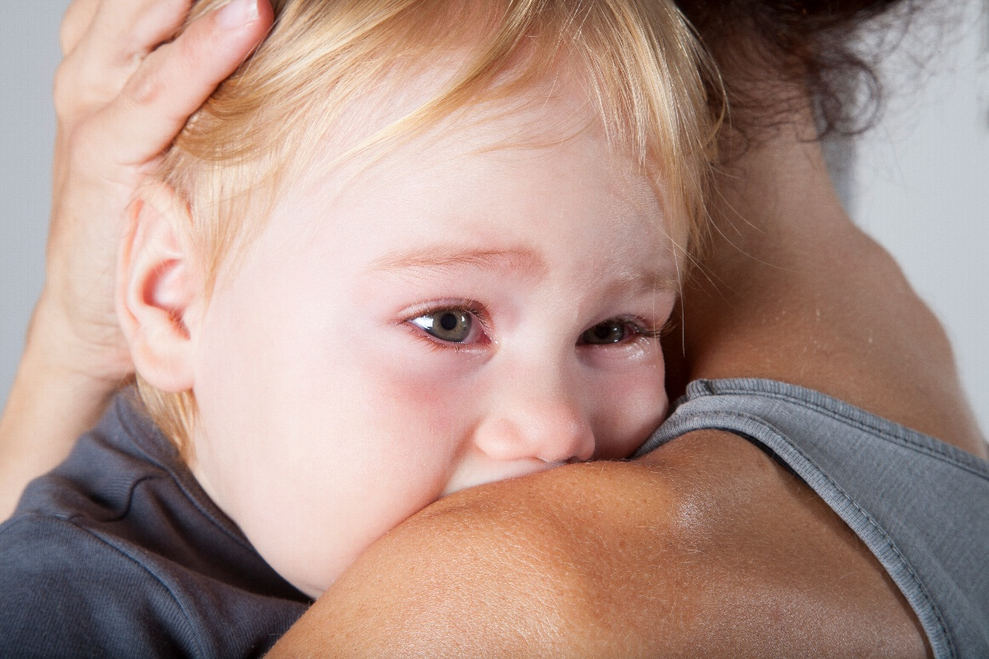
Children are Unique
Children are classified by the US Department of Health and Human Services (HHS) as an “at-risk population,” due to their unique anatomical, physiological and psychological differences.
Reliance on Caregivers
Communication & Identification
Mobility
Physical Needs
Nutritional Needs
Emotional Needs
Routine and Comfort

Slide 32
Impact of Disasters on Children
The emotional effects of disaster on minors vary by age and developmental level and can include being anxious, ashamed, fearful, helpless, confused, or insecure.
These feelings are exacerbated by unfamiliar routines, unusual eating patterns, and inactivity.
Even minors who are not separated from their families experience many negative effects from stays in shelters and long-term temporary housing.
For minors, these feelings can be expressed through anger, anxiety, aggression, and participation in risky behaviors.

Slide 33
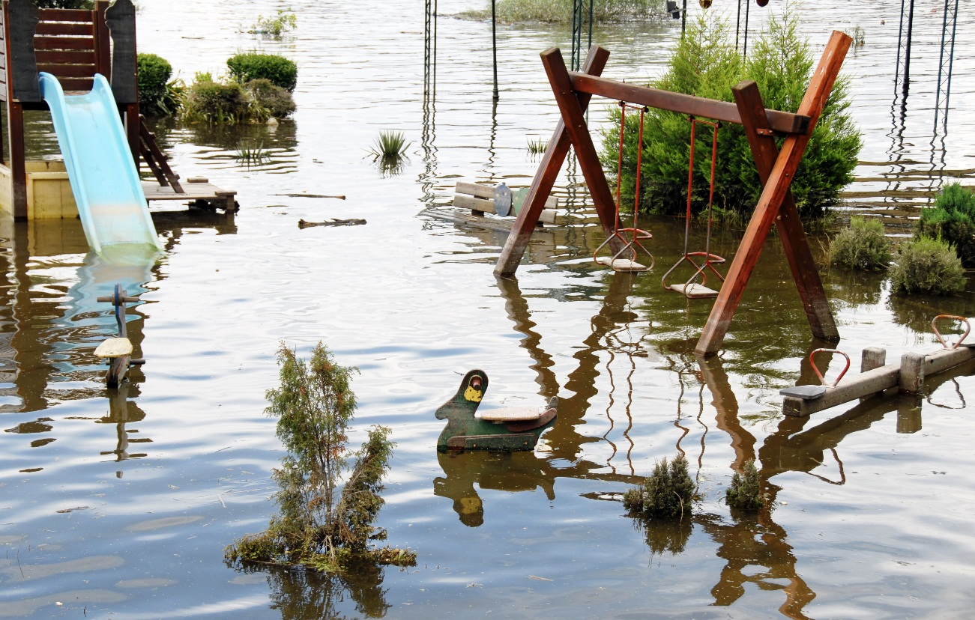
Impact of Disasters on Children
Without sufficient planning, conditions in shelters and temporary housing can deteriorate and leave minors especially vulnerable to crime, fighting, and physical and sexual abuse.
Research has found that family cohesion and calm adult response after disaster can be a mitigating factor in helping youth process and recover from emergencies or disaster.

Slide 34
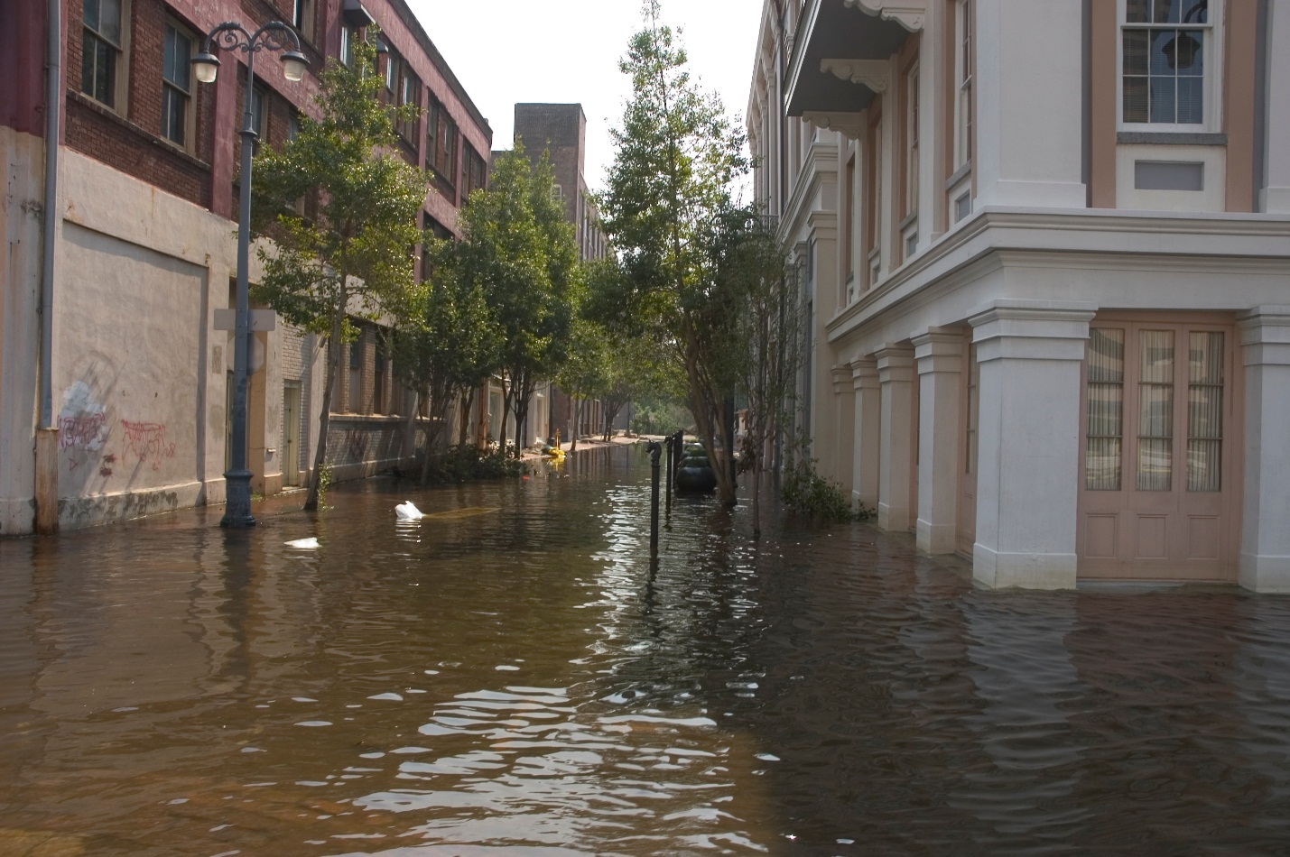
Hurricanes Katrina and Rita
1.5 million people, including 163,000 children displaced in Louisiana and Mississippi
Nearly 5,000 children were separated from their families for as long as 18 months

Slide 35
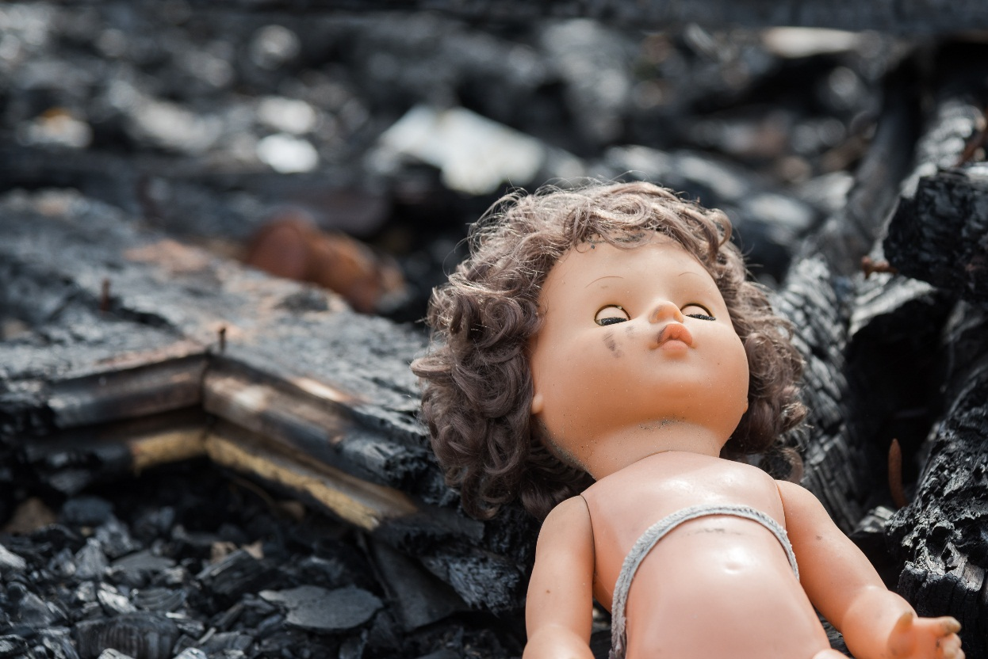
Hurricanes Katrina and Rita
According to the National Commission on Children and Disasters, children exposed to Hurricane Katrina were the following:
• Nearly five times as likely as to exhibit serious emotional disturbance than before the hurricane;
• More likely to experience emotional or behavioral problems that they did not experience before the hurricane; and
• Unlikely to receive psychological help needed after the hurricane.

Slide 36
Impact: Katrina
Children displaced by Katrina were 4.5 times more likely to have symptoms consistent with serious emotional disturbance
34% of middle or high-school children were one or more years older than appropriate for their grade (compared to 19% of all children in south)
60% of children displaced by Katrina to congregate settings either have serious emotional disorders, behavioral issues and/or are experiencing significant housing instability
50% of households who had been displaced for at least one year were still living in unstable conditions after four and a half years
“Legacy of Katrina: The Impact of Flawed Recovery on Vulnerable Children of the Gulf Coast”, Children’s Health Fund and the National Center for Disaster Preparedness, Columbia University Mailman School of Public Health, August 2010.

Slide 37

Resource: Camp Noah
A Camp Noah event is organized in a disaster-impacted community in partnership with local organizations or groups.
Camps are held in kid-friendly facilities in impacted communities. Camp Noah events are typically held six months to two years after a disaster or traumatic event, but can also be organized independent of a disaster to equip children with preparedness and resiliency skills for life.
1.800.987.0061

Slide 38
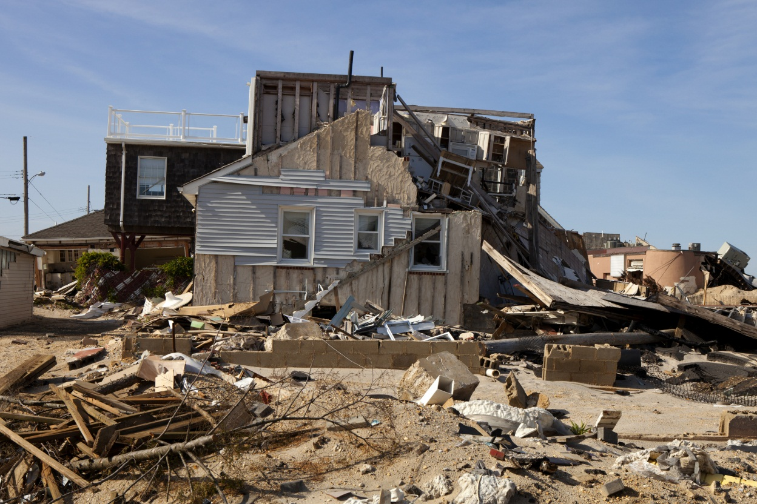
Superstorm Sandy
A recent report from the US Department of Health and Human Services’ Office of Inspector General (OIG), The Response to Superstorm Sandy Highlights the Importance of Recovery Planning for Child Care Nationwide, provides further insight on these issues, and highlights the challenges faced by child care providers in the aftermath of Superstorm Sandy.

Slide 39


SUPERSTORM SANDY
Some, but not all, child care programs were eligible for reimbursement under the Public Assistant grant program.
Delays in communication from state officials about the types of assistance available, one state delayed communication about grant funding until a year after the storm.
697 Child Care Providers in Connecticut, New Jersey and New York Closed
Families sought child care services elsewhere, with some families never returning when the facility reopened
Closure time varied, from one month up to eight months.
Copyright Child Care Aware® of America.
Notes:
NOTE: To replace a picture, just select and delete it. Then use the Insert Picture icon to replace it with one of your own!

Slide 40
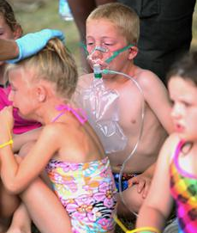
How Would You Respond?
More than 70 people went to hospitals today after being overcome by fumes from a water-purification chemical at a city pool, according to news reports.
Swimmers, including many children, suffered coughing, nausea and eye irritation after a reported chemical spill about 2 p.m.
Two buses took 50 people to area hospitals, and 21 were taken by ambulance.

Slide 41
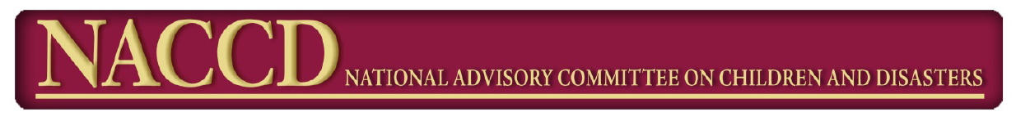
Healthcare Preparedness for Children in Disasters:
A Report of the NACCD Healthcare Preparedness Working Group
Nov. 2015

Slide 42

How Prepared are Hospitals for Pediatric Disaster Needs?
Only 47% of hospitals actually have disaster plans that include pediatric-specific needs
Only about 6% of EDs in the United States have all of the supplies deemed essential for managing pediatric emergencies
National Advisory Committee on Children & Disasters- Healthcare Preparedness for Children in Disasters: A Report of the NACCD Healthcare Preparedness Working Group; 11/13/15

Slide 43
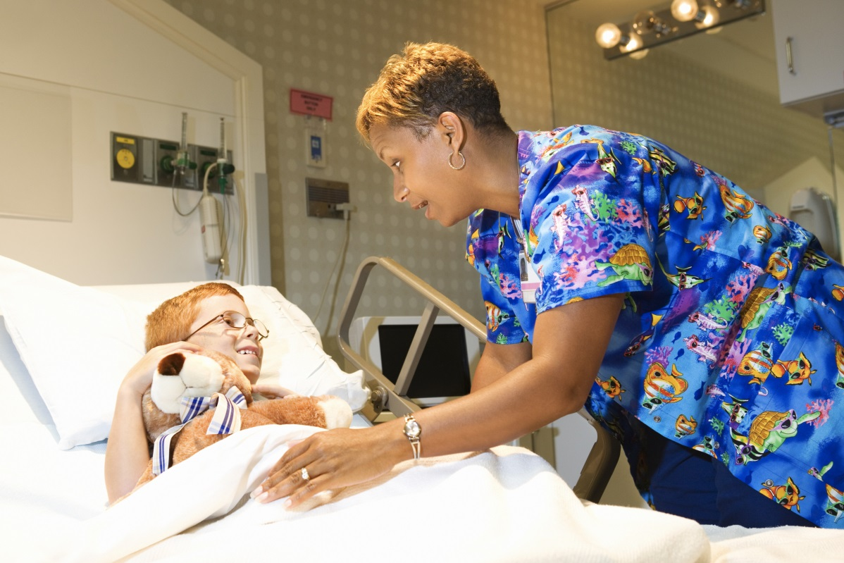
Healthcare Preparedness for Children in Disasters
Recommended Focus Areas:
Disaster Coalition Enhancement
Workforce Development
Medical Countermeasures
National Advisory Committee on Children & Disasters- Healthcare Preparedness for Children in Disasters: A Report of the NACCD Healthcare Preparedness Working Group; 11/13/15

Slide 44
Healthcare Preparedness for Children in Disasters
Disaster Coalition Enhancement
Enhance and improve children’s disaster coalitions to ensure that they are comprehensive, integrated, multi-disciplinary, regionalized to optimize a team approach. When incorporated into overall disaster planning and management, pediatric disaster coalitions are one of the most effective mechanisms to match resources to needs during catastrophic events.
A “mutual aid” approach is ideal—using existing models to support the development of others
Break down silos and allow for professional collaboration
There is a need to create a guideline and template best practice plan for regional pediatric disaster coalitions that can be customized and utilized by all coalitions to provide a standardized approach and best outcomes for children in a disaster.
Support the education and engagement of alternate caregivers in advocating for children in a disaster.
National Advisory Committee on Children & Disasters- Healthcare Preparedness for Children in Disasters: A Report of the NACCD Healthcare Preparedness Working Group; 11/13/15

Slide 45
Pediatric Champion
Serve as a liaison to standing hospital pediatric care committees (if hospital cares for children at all during normal operations) or having the ability to stand up such a committee during an incident.
Serve as a liaison to inpatient nursing and a definitive care hospital (regional pediatric referral center with pediatric-capable trauma center), integrating services and facilitating patient transfers.
Organize ED nursing continuing education in emergency/disaster pediatric care and providing pediatric orientation for new staff members.
Help develop, and periodically review and revise policies and procedures for pediatric emergency care.
Monitor pediatric medical equipment and medication availability.
Provide emergency evaluation and care to children during a disaster.
State of Michigan, Pediatric Preparedness Toolkit

Slide 46
Healthcare Preparedness for Children in Disasters
Workforce Development Recommendations:
Front-line personnel who are charged with caring for children affected by disasters need to be trained, organized, and resilient. (Paramedics, EMTS, nurses, physicians, other important caregivers)
  Develop training standards and curriculum for a pediatric disaster preparedness training program
  Include all types of first responders in the training--- including school personnel and child care providers
  Improve pediatric emergency transport and patient care capabilities
  Assess the state of existing technology to aid in tracking and reunification
  Work with FEMA and SAMHSA to address mental health
National Advisory Committee on Children & Disasters- Healthcare Preparedness for Children in Disasters: A Report of the NACCD Healthcare Preparedness Working Group; 11/13/15

Slide 47
Healthcare Preparedness for Children in Disasters
The nation’s ability to dispense medical countermeasures to children has significantly improved, but gaps do remain.
Medical Countermeasure Recommendations:
Collaborate with partners to promote alternate means of quickly assessing dosage requirements for children
Promote development of alternative drug delivery methods
Develop a standard list of medications and devices which should be stockpiled in pharmacies for chemical emergencies
National Advisory Committee on Children & Disasters- Healthcare Preparedness for Children in Disasters: A Report of the NACCD Healthcare Preparedness Working Group; 11/13/15

Slide 48

Recommendations: Pediatric Safety
Children should be weighed in kilograms
If child is not weighed, a standard method for estimating weight in kilograms should be used
Blood pressure and pulse oximetry monitoring should be available for children of all ages
Guidelines for Care of Children in the Emergency Department – AAP, EMSC and Children’s National Medical Center

Slide 49
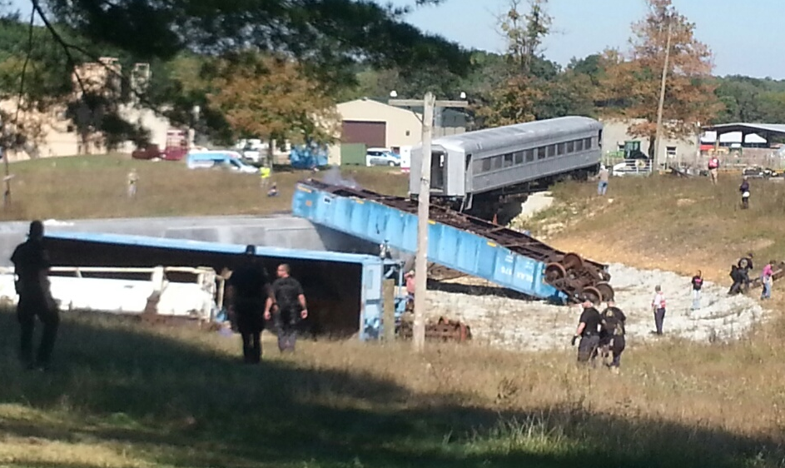
Recommendations: Drills
Routinely conduct disaster drills. Include a pediatric element into these drills.
Consider conducting a pediatric mass casualty drill at least every 2 years.
Guidelines for Care of Children in the Emergency Department – AAP, EMSC and Children’s National Medical Center

Slide 50
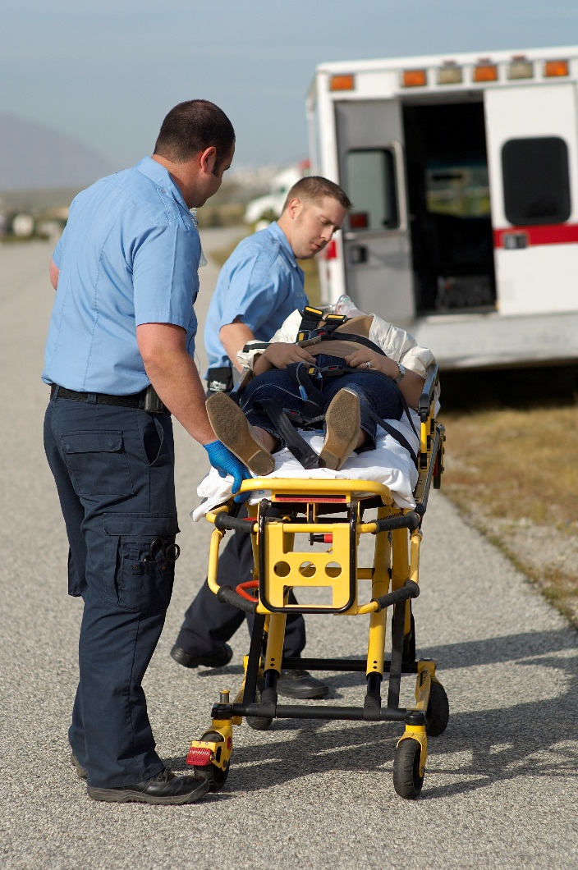
Recommendations: Procedures/Policies
Physical or chemical restraint of patients
Family presence during emergency care
Death of a child
Death of a parent
Decontamination, isolation, quarantine of families
Guidelines for Care of Children in the Emergency Department – AAP, EMSC and Children’s National Medical Center

Slide 51
Other Considerations
Identification bands for children, when arriving at hospital
Procedures to care for unattended children brought into the hospital
Awareness of available pediatric equipment – ventilators, circuits, isolettes, I/O
Keeping families together during decontamination
Appropriate sized gowns, masks, etc.
Disinfection of toys
Consider conducting a pediatric mass casualty drill at least every 2 years.

Slide 52

RESOURCES
Child Care Aware of America
www.ChildCarePrepare.org
Pediatric Readiness Project
pediatricreadiness.org
American Academy of Pediatrics
EMS for Children Program
Copyright Child Care Aware® of America.
Notes:
NOTE: To replace a picture, just select and delete it. Then use the Insert Picture icon to replace it with one of your own!

Slide 53
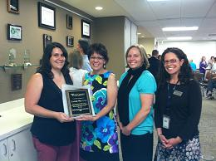
Resources: Reunification
Public Health Hero of the Year Award
United Way’s 2-1-1 received the Public Health Hero of the Year Award from the Tri-County Health Department (TCHD) for its role during the aftermath of the Aurora Theatre Shooting. 2-1-1 Served as a single point of contact for families and loved ones by reducing the number of calls to hospitals, reuniting victims with their families which allowed hospitals and victims to focus on healing efforts

Slide 54

Resources: Reunification
Call Line Staffed 24/7
1-800-THE-LOST
Can pull from over 200 volunteers to assist during disasters, other emergencies

Slide 55

Help build children’s resilience and ability to cope with crisis through book reading
Books are a natural way to support children as they face many life events and are dealing with their developing feelings.

Slide 56
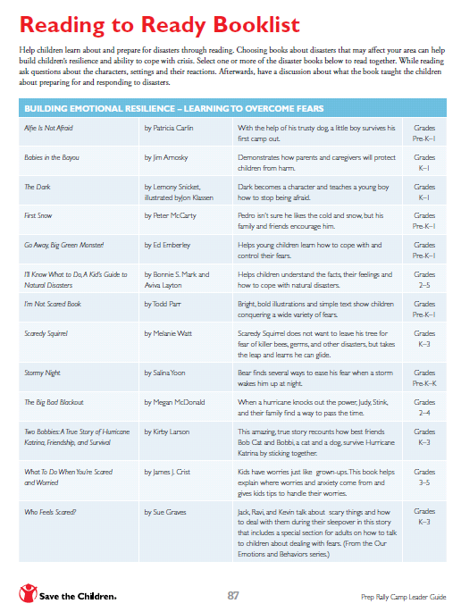

www.savethechildren.org/GetReady

Slide 57
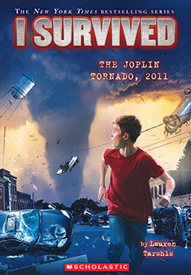
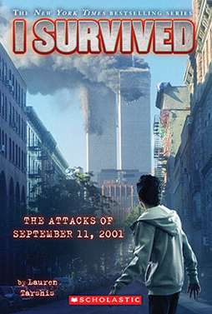
I Survived Series
Series written by Lauren Tarshis
Historical fiction series
Focuses on historic disasters
Follows the main characters on a soul-searching quest, as they discover how resilient they truly are and find out that they are also survivors.
http://isurvived.scholastic.com/

Slide 58
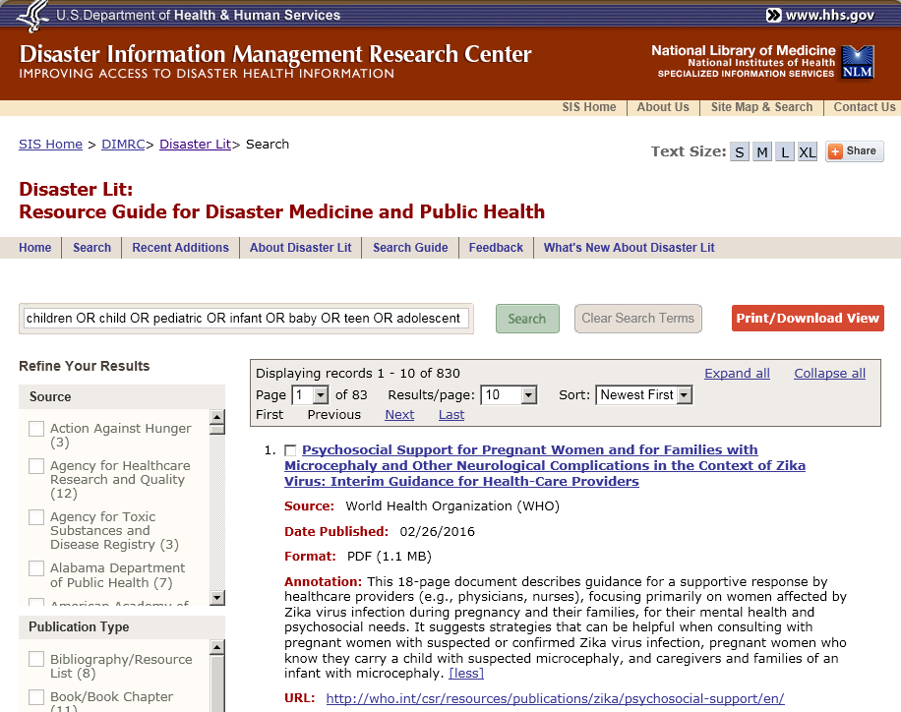
Disaster Lit: the Resource Guide for Disaster Medicine and Public Health
Database of links to disaster medicine and public health documents available on the Internet at no cost from over 700 organizations for a professional audience
Expert guidelines
Research reports
Conference proceedings
Training classes
Fact sheets
Websites

Slide 59
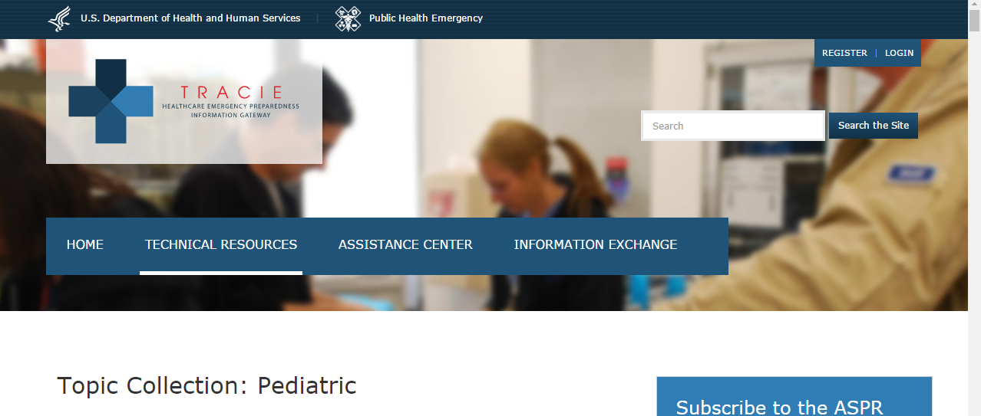
TRACIE
This Topic Collection from TRACIE (Technical Resources, Assistance Center, Information Exchange) provides resources that can help healthcare facilities, healthcare coalitions, and other health and medical providers to consider the specialized care and resources needed for children prior to, during, and after an incident.
https://asprtracie.hhs.gov/technical-resources/31/Pediatric/0
Resources are categorized in topics that include Chemical, Biological, Radiological, Nuclear, and Explosive (CBRNE) and Terrorism; Education and Training; Guidelines and Protocols; Lessons Learned; Pediatric Surge Capacity; and Plans, Tools, and Templates.

Slide 60
EMERGENCY PREPAREDNESS
Andrew Roszak, JD, MPA, EMT-P
Senior Director
Emergency Preparedness
Andrew.Roszak@usa.childcareaware.org
@AndyRoszak
Copyright Child Care Aware® of America.
Notes:
NOTE: To replace a picture, just select and delete it. Then use the Insert Picture icon to replace it with one of your own!

